Slide 1
SDLC
Software Development Life Cycle
- Atharva Puranik

Slide 2
SDLC
SDLC stands for Software Development Life Cycle.
Systematic approach for the software development.
Provides Framework for Development.
Adapts to changes with flexible methodologies.
Ensures timely delivery by following a structured timeline.
It ensures that software meets the desired quality.

Slide 3
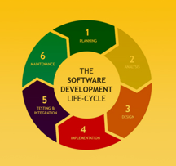
SDLC Phases:
Planning: Define goals, scope, resources.
Analysis: Gather and understand requirements.
Design: Create software blueprint.
Implementation: Write code.
Testing & Integration: Ensure quality, combine components.
Maintenance: Support, fix issues, improve.

Slide 4
Types of SDLC:
Waterfall Model
Iterative Model
V-shaped Model
Spiral Model

Slide 5
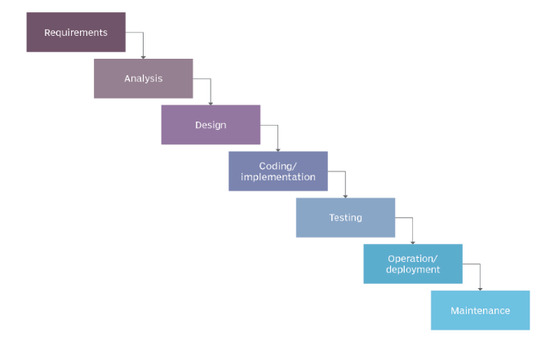
Waterfall Model
Linear sequential approach.
Each phase must be completed before moving to the next.
Suitable for small projects with well-defined requirements.
Disadvantages : Rigid, inflexible

Slide 6

Example of Waterfall Model
Construction projects –
Design, foundation, and building follow a strict, linear order, with no phase overlapping or revisiting.

Slide 7
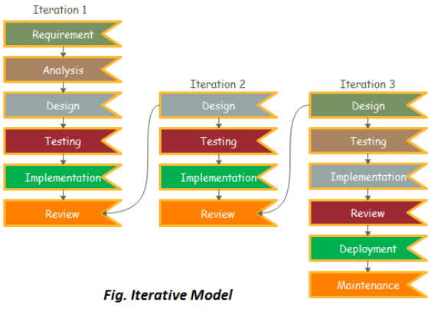
Iterative model
Development is broken into iterations or cycles.
Each iteration delivers a working product increment.
Disadvantage: Can be challenging to manage multiple iterations, requires good planning.

Slide 8
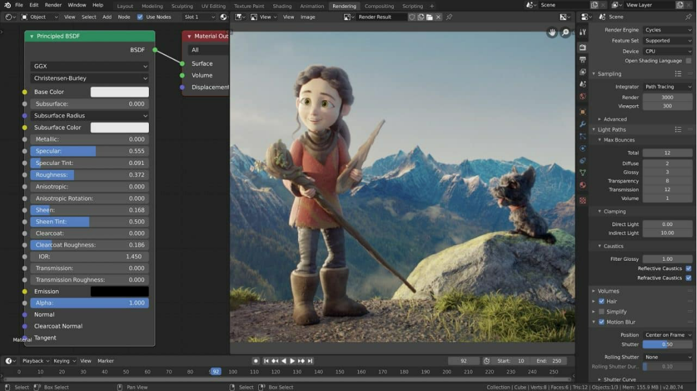
Example of Iterative Model
Game development –
Features are built, tested, and improved in cycles, allowing for incremental refinement and feedback-driven updates.

Slide 9
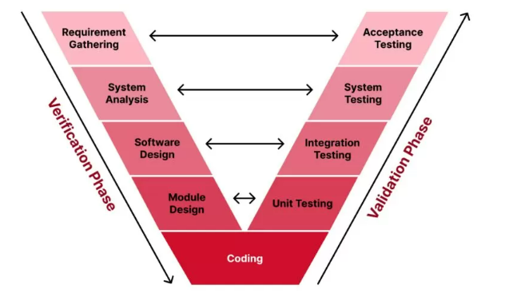
V-shaped Model
Verification and validation-oriented.
Each development phase has a corresponding testing phase.
Testing activities are planned in parallel with development phases, ensuring early defect detection.
Disadvantage : Time consuming, Risk Management.

Slide 10

Example of V- Shaped Model
Medical device software –
Each phase of development (like requirement gathering) has a corresponding validation phase (like user acceptance testing) to ensure precision.

Slide 11
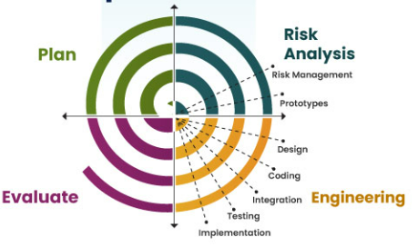
Spiral Model
Iterative and incremental approach with risk management.
Each iteration involves planning, design, development, and evaluation.
Disadvantage : Can be complex to manage.

Slide 12

Example of Spiral Model
Aerospace projects –
Continuous refinement with risk assessment at every stage ensures safety and innovation while managing high-stakes risks.

Slide 13
From my perspective, the correct approach for many software development is the Spiral Model.
Iterative: The project is divided into small chunks or iterations.
Risk-focused: Each iteration starts with identifying and addressing potential risks.
It's adaptable - If things change during development, the Spiral Model allows you to adjust your plans accordingly.
It involves customers: Getting feedback from users throughout the process helps ensure you're building the right product.
Spiral approach was used by various organizations such as NASA, IBM,…. etc.

